Slide 1
Emotion (In Greater Depth)
This core material is strangely missing from the Griggs Textbook.. Will be in online textbook and on 2nd midterm

Slide 2
The Big Questions / Issues
Emotion beyond basic top-down / bottom-up:
What is relationship between biology and feeling?
Are all emotions universal?
Are all emotions motivational states? What is their function?
Key practical points:
How to be happy?
What to do about anger, anxiety, stress?

Slide 3
Defining Terms
Emotion is short lived psychological state that:
Activates specific emotional neural systems
(amygdala, ventral striatum, ventral-medial PFC)
Has characteristic subjective feeling
Triggers physiological changes (heart rate etc)
Also cognitive changes (thinking is altered)
And behavioral responses (behavior is affected)
Mood is long lasting, less intense, not triggered
Affect is simple “map” for categorizing emotions
valence (good / bad)
arousal (high / low)

Slide 4
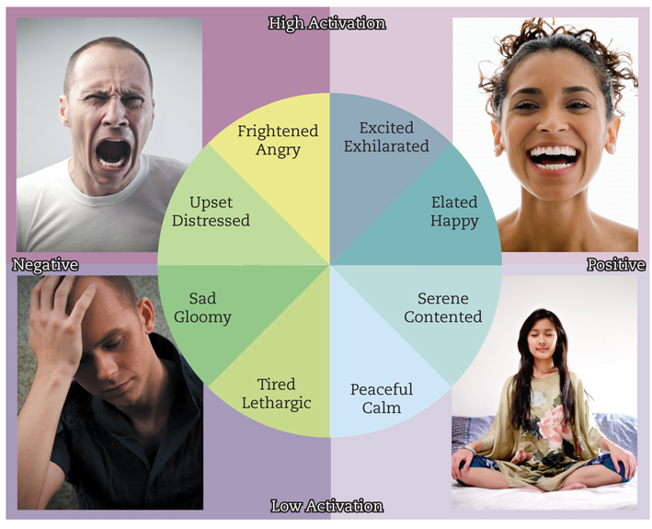
Valence vs. Arousal

Slide 5
Basic Emotions
Fear, Anger, Sadness, Happiness, Disgust, Contempt, Surprise/Interest
Why are these basic? What causes them? What benefits do they provide? Why only 1 positive?
Where are Love and Hate?
Why not Pain? Hunger? Lust?

Slide 6
The Face of Emotion
These facial expressions are universal.
What are they!?

Slide 7
News Flash: “Not” Face Discovered!
C. F. Benitez-Quiroza, R. B. Wilburb, A. M. Martinez (2016), Cognition, 150, 77-84

Slide 8
Emotion for Communication
It is important to communicate emotion – hence facial expressions.. And emoticons :)
Display rules are cultural conventions about when and how to display emotions: intensify, de-intensify, mask, neutralize

Slide 9
How often do you display..
I modify my emotional display..
Typically once a week or more
Typically around once a month
Maybe once per year
Never

Slide 10
Emotion = Motivation
Emotions drive motivation, learning: without them everything is neutral and you can never decide!
Fear: avoid bad things; Anger: attack bad things
Disgust: don’t eat rotten things
Contempt: punish bad people
Happiness: approach, enjoy good things
Surprise/interest: learn about unexpected things
What is the point of Sadness!?

Slide 11
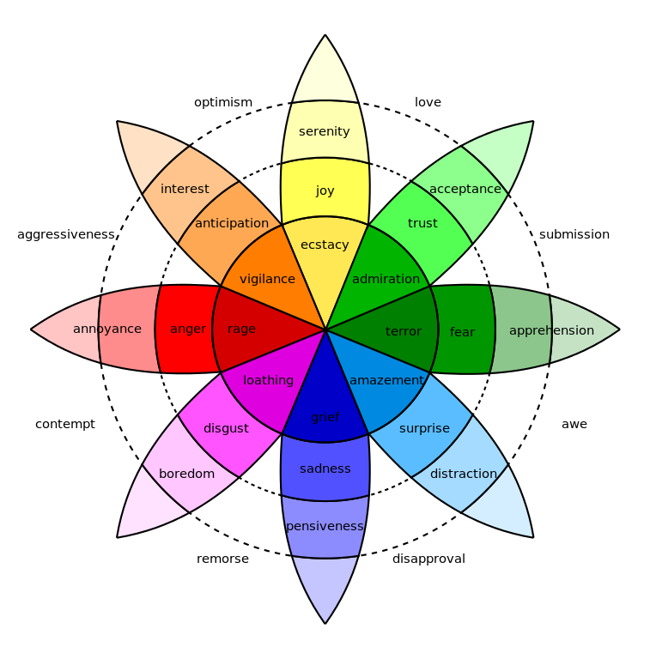
Robert Plutchik

Slide 12
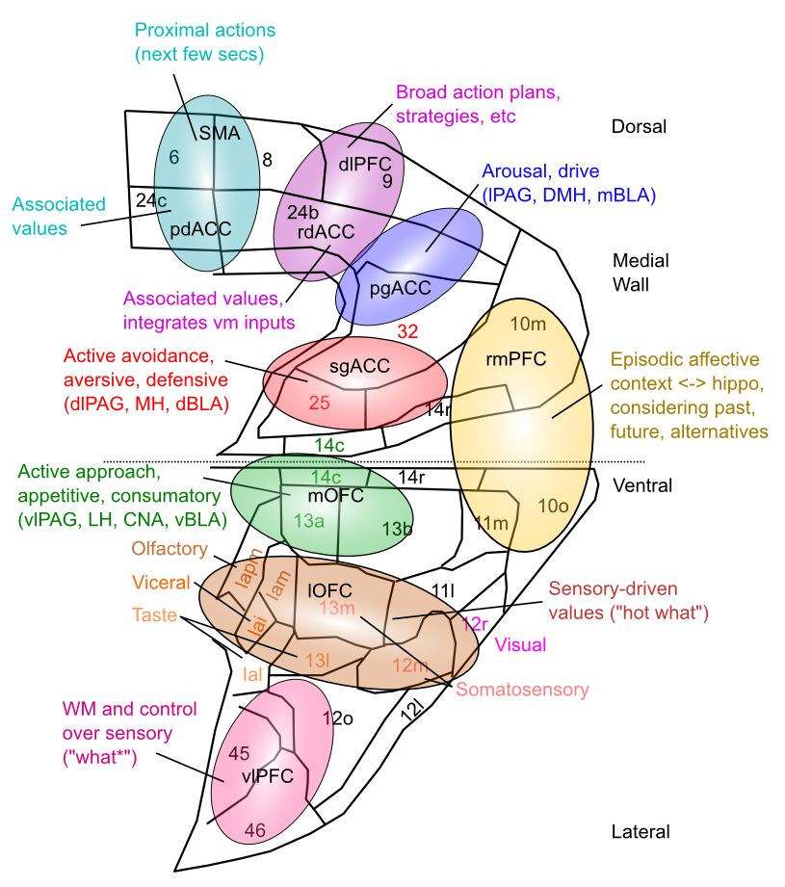
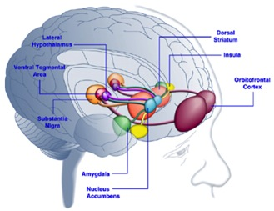
Map of Emotions in vmPFC
Valence: 25 vs 13/14?
Arousal: intensity, also pgACC
Driven by subcortical connectivity
High-dimensional, multi-factorial representation
Consistent with fMRI, MDD in sgACC, etc

Slide 13
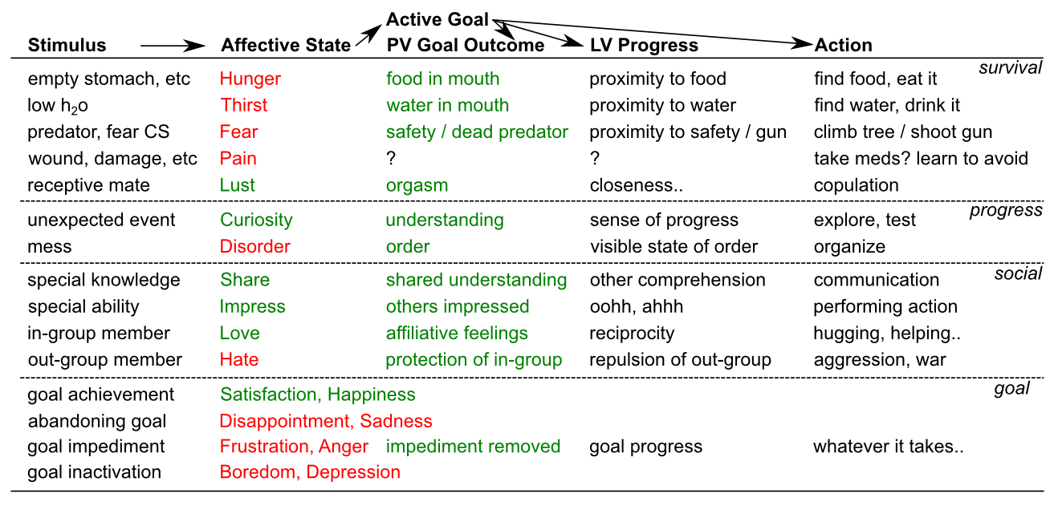
Sample Goal Taxonomy

Slide 14
The emotional brain

Slide 15
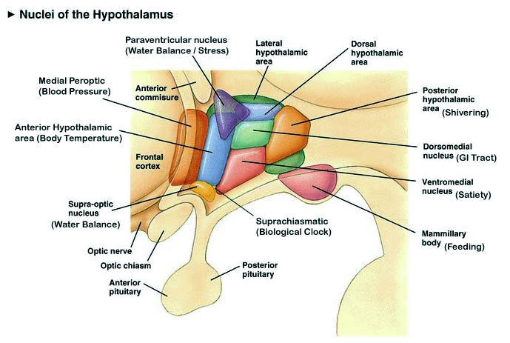
Basic Drives: Hypothalamus

Slide 16
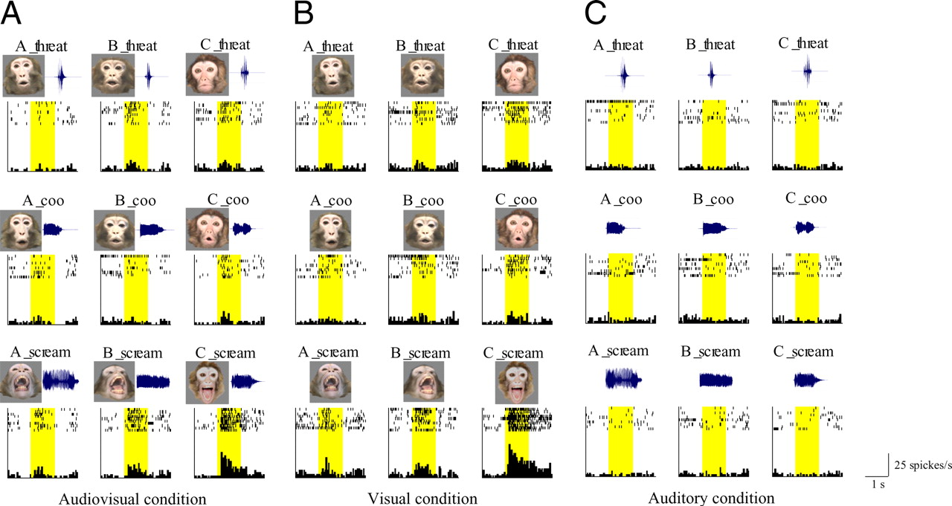
Amygdala Encodes Different Emotions

Slide 17
Self Help Psychology
What is Happiness, and how can I get it?
What is Anger, and what can I do about?
What about Fear?
Stress? Does it affect Health?

Slide 18
The Two Faces of Happiness
Happiness = instantaneous emotional feeling
Happiness = long-term life satisfaction
Good news: everybody’s happy-ish!
Bad news: some people aren’t!
Parents are low on instantaneous, high on long-term..

Slide 19
I would be happier if..
A. I won the lottery
B. I became a paraplegic
C. No difference (long term)

Slide 20
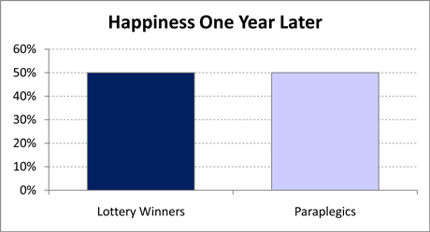
Surprise!?

Slide 21
Money != Happiness
Above ~$50k, more $ != more happiness
So what does = more happiness?
Immediate social network, relationships
Standing in community / social recognition
Goal achievement
Dopamine driven by social feedback and progress toward goals!!!
And a major (50%) contribution of genes..

Slide 22
Negative Emotions
Happy families are all alike; every unhappy family is unhappy in its own way.
- Leo Tolstoy, Anna Karenina
We have many more negative emotions than positive ones!
So we should learn to accept this fact!

Slide 23
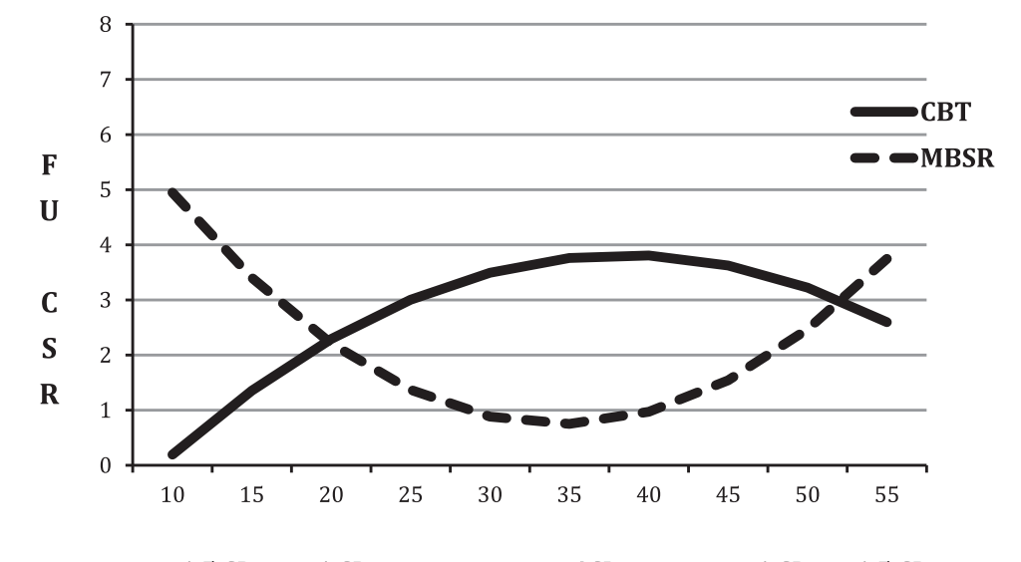
Johanna Arch: Mindfulness Based Stress Reduction Therapy
Acceptance is powerful medicine!

Slide 24
Anger is not a liquid
You don’t have to vent it! Leads to rehearsal..
Figure out the underlying source of frustration
Deal with it
And / or learn to accept the situation

Slide 25
Stress Management..
Stress is mostly “in your head” – does all this stuff really matter that much, or perhaps not??
To reduce stress, become a Boulderite:
Exercise
Meditation
Optimism
Sunshine, fresh air, etc..

Slide 26
I Get Sick When..
A. I’m currently under stress
B. After the stressor is over
C. When I am feeling cold / underdressed

Slide 27
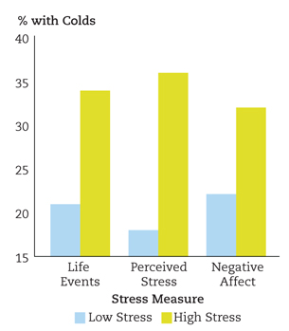
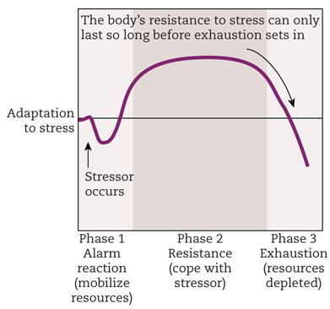
Stress THEN Sick
Stress itself does not make you sick..
It is the depletion period AFTER the stressor is over that makes you sick!

